Slide 1
Neural tangent kernel

Slide 2
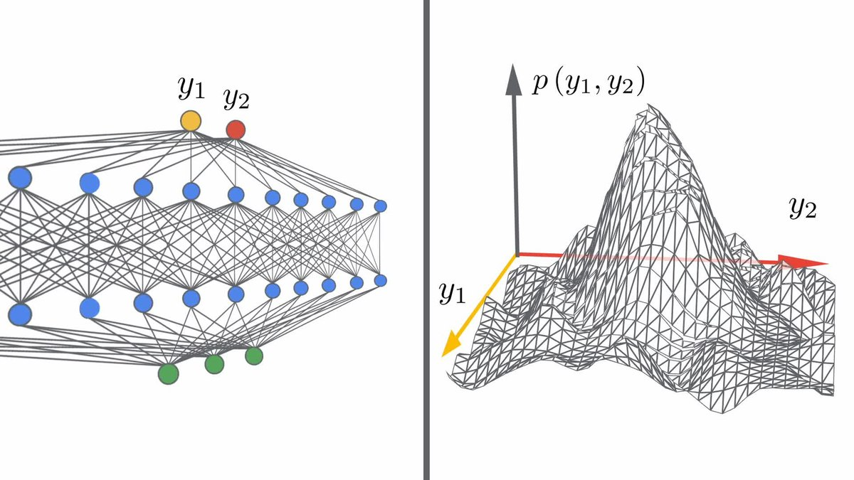
Wide neural nets and Gaussian processes

Slide 3

Neural tangent kernel
NTK converges to Θ with width of NN tends to infinity
Θ stays constant during trainig

Slide 4

Linearised regime of an NN

Slide 5




Problem with the kernels
If
Then
With width of a NN tends to infinity,
and

Slide 6


Proposition

Slide 7
LogLikeliHood
 | Concrete | CASP | Boston house | Red wine
NNGP analytic | -42088 | -125352 | -9757 | -1079
NTKGP analytic | -79443 | -92627 | -4735 | -989
Deep ensemble | -113514 | -8347 | -3468 | -2441
RP-param | -74198 | -9157 | -3716 | -2461
NTKGP-param | -58075 | -9615 | -2785 | -895

